Slide 1
Local RAG LLM
Proprietary Document Knowledge base & Generative AI

Slide 2
Executive Summary
The goal of this project is to implement a Local Language Model (LLM) capable of reviewing, summarizing, and leveraging proprietary documents.
The LLM will run on a laptop equipped with a 6GB RTX 3060 GPU and 32GB RAM.
The system will:
take a list of files as input
provide answers to questions about these files
summarize the content
assist in writing new documents based on the provided information.
This project will be reused after the class for developing documentation from existing proprietary documents at students current employer.

Slide 3
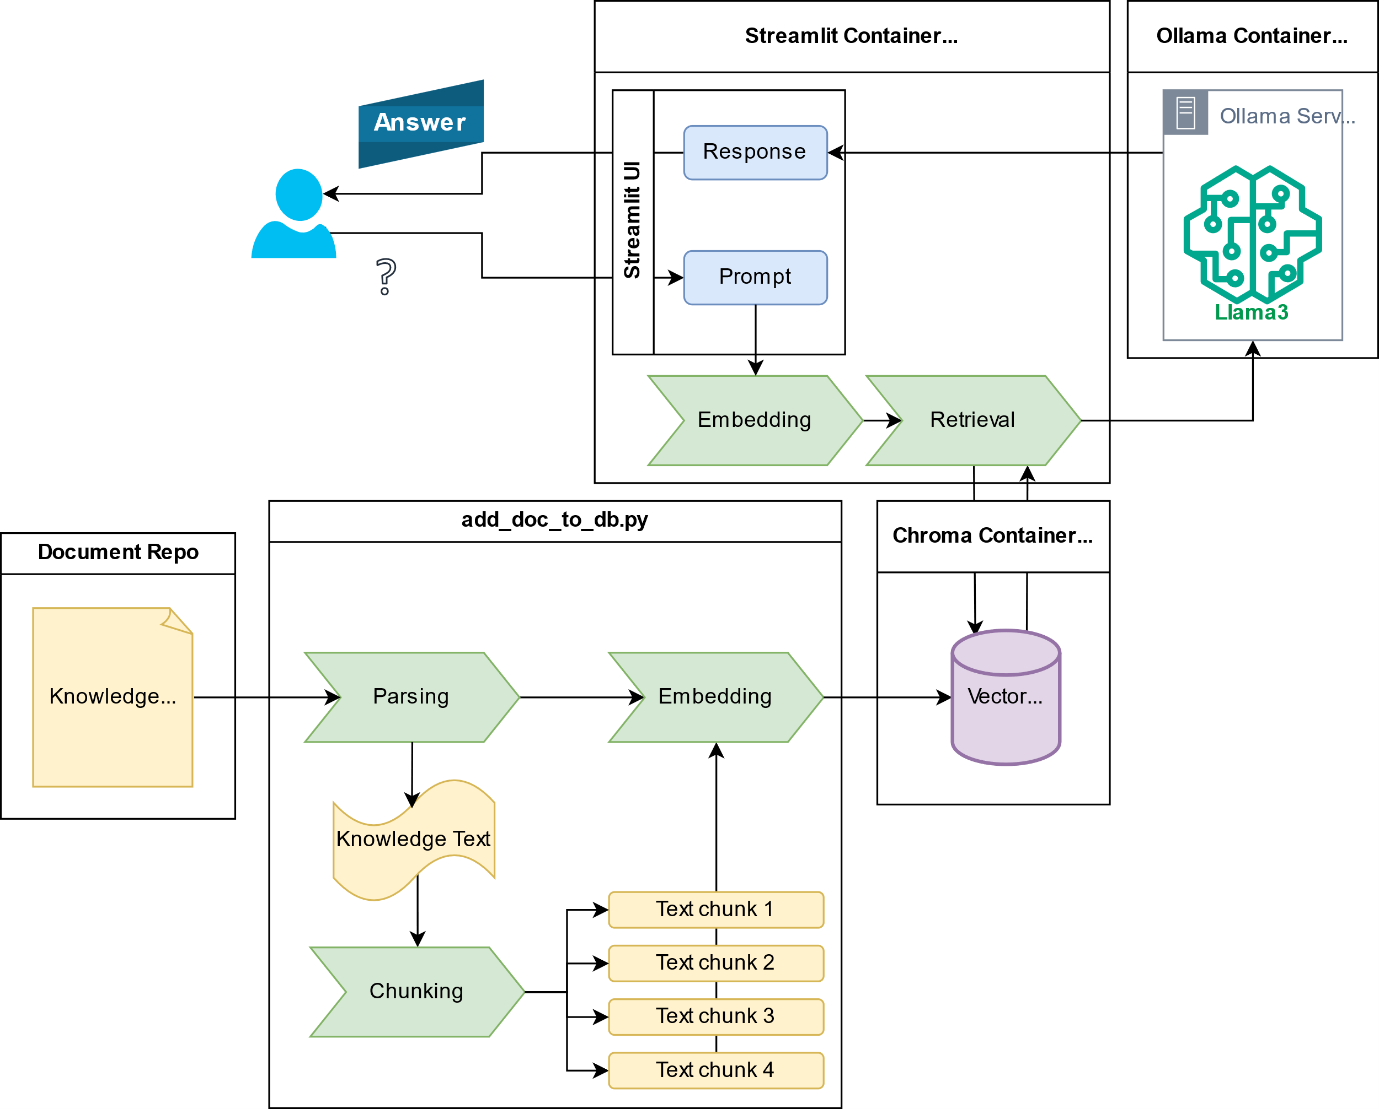
Local RAG LLM Overview

